Slide 1

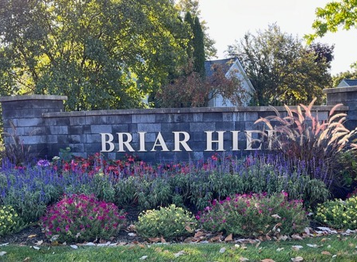
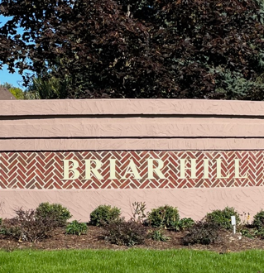
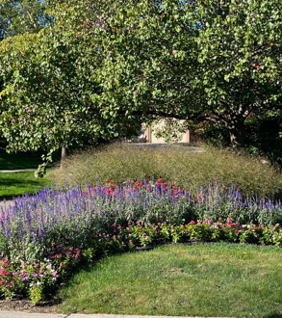
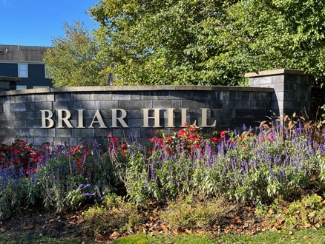
Briar Hill Subdivision
Townhall Meeting
July 23, 2025

Slide 2
Agenda
Welcome
By-Laws Update
Next Steps
Volunteer Opportunities
Questions And Answers

Slide 3
Current Briar Hill Board Members
Jan Hewett - President janhewett@comcast.net
Shari Gordon – Vice-President (Secretary) sharig08@gmail.com
Alan Knaus – Treasurer alanknaus@comcast.net
Kishor Khankari – At Large Member khankari@comcast.com
Phil Wyckstandt – At Large Member pwyckstandt@comcast.net
Patrick Kelley – Property Manager patrick@inrhodes.com
Thayer Moran – VP, InRhodes thayer@inrhodes.com
(InRhodes Property Management Company)

Slide 4

Why are we making these changes
1. Original document created by the developer - ~30+ years old.
2. Missing sections routinely found in HOA governing documents today.
3. Modernizing the document will help the community run smoothly.

Slide 5
Updates to Laws/ Regulations
1. Michigan Compiled Laws (MCL) and Statutory requirements
2. Missing new laws and/or updated laws/regulations, e.g., solar panels, rentals, electric vehicles, etc.
3. Changes to Bylaws, Articles of Incorporation and Master Deed

Slide 6
Rentals
1. Clearer Rental Rules
2. Standard Lease Agreement
3. Limit Corporate Ownership

Slide 7
Meetings - Quorum
1. Membership Voting - Quorum Provisions
Revision to the percentage required to reach quorum so that needs of the HOA can be met. Historically, the annual meeting fails to reach a quorum for actions/votes proposed.

Slide 8
Compliance
1. Supporting Neighborhood Pride: By maintaining homes and properties in harmony with established community guidelines, we help ensure a welcoming and well-cared-for environment that everyone can enjoy.
2. Preserving Property Values: Consistently upholding HOA bylaws contributes to the overall appeal of the neighborhood. When properties are thoughtfully maintained, it helps protect the value of everyone’s home and keeps our community desirable.

Slide 9
Next Steps
1. Neighborhood Champions
2. Documents sent to Co-Owners
3. Ballot sent (90-day clock)
4. Votes returned by mail, email
5. Assessment of votes

Slide 10
Neighborhood Champions
The Board is seeking volunteers to help guide the community through the upcoming By-Laws amendment process. Your voice matters – and your help can make a difference!
Talk with neighbors about the proposed By-Laws changes and gather their thoughts to share with the Board.
If you are interested in lending a hand, please reach out to:
Jan Hewett (janhewett@comcast.net)
Alan Knaus (alanknaus@comcast.net)
Assist with friendly, door-to-door outreach to secure the approval of 2/3 of Briar Hill homeowners (120 homes needed).
Help plan and share helpful materials like FAQs, community notices, and attend in-person gatherings.

Slide 11
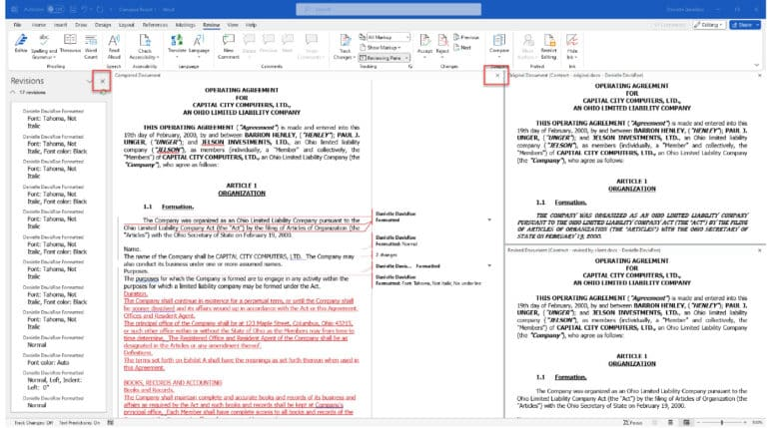
How will I review the old document with the new changes?
Each homeowner will receive a red-line version of the old bylaws and a clean version with the new information.

Slide 12
Will when this happen?
1. Summer 2025 – In-Person meeting(s), post-cards, one-page announcements, attendance at board meetings and talking to board members
2. Fall 2025 – Ballot with red-line and clean version of governing documents mailed to every household in HOA.
Start of 90-day formal ballot/vote process.
3. December 2025 – Final vote is due (exact date to be announced).
End of December/early January – Ballot Results Announcement.

Slide 13

Questions And Answers

